Slide 1
AZ-304: Microsoft Azure Architect Design

Slide 2
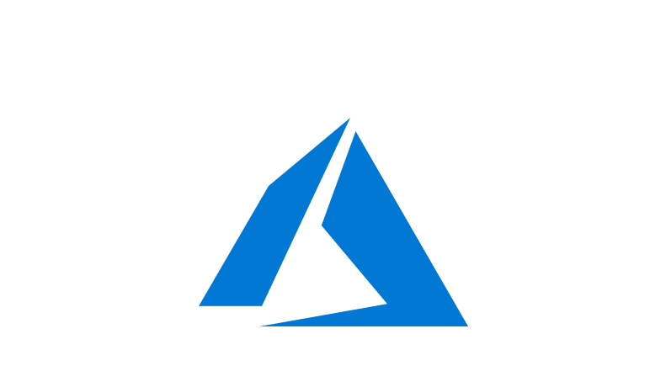
Course Outline
Module 1: Design a Compute Solution
Module 2: Design a Network Solution
Module 3: Design for Migration
Module 4: Design Authentication and Authorization
Module 5: Design Governance
Module 6: Design a Solution for Databases
Module 7: Select an Appropriate Storage Account
Module 8: Design Data Integration
Module 9: Design a Solution for Logging and Monitoring
Module 10: Design a Solution for Backup and Recovery
Module 11: Design for High Availability
Module 12: Design for Cost Optimization
Module 13: Design an Application Architecture
Module 14: Design Security for Applications
NOTE: The module order listed above aligns with the learning objectives described on the AZ-304: Microsoft Azure Architect Design certification page.

Slide 3
Module 9: Design a Solution for Logging and Monitoring
Solutions for Monitoring using Azure Monitor

Slide 4
Learning Objectives
Monitoring
Azure Monitor
Module Review Questions

Slide 5

Monitoring

Slide 6

Monitoring Azure
Traditional application and infrastructure monitoring is based on whether the application is running or not, or what response time it is giving
This lesson summarizes the following recommendations for:
Application Monitoring
Platform Monitoring
Monitoring Best Practices
See: Issue tracking

Slide 7
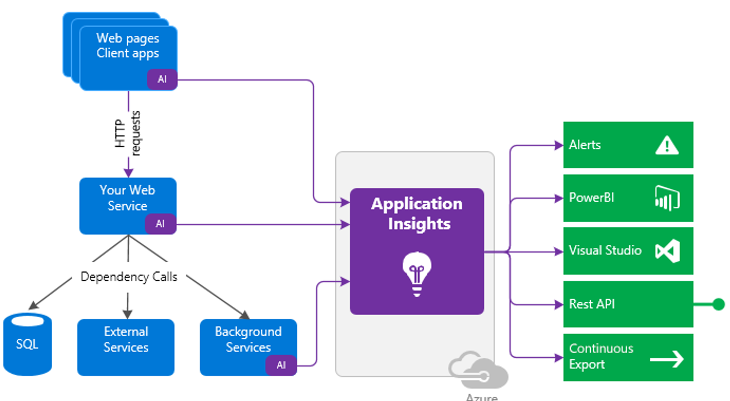
Application Monitoring
Application Insights:
Default dashboard with most important metrics
Performance statistics from a client and server
Smart Detection - anomalies in performance or utilization patterns
Usage Analysis
Cross-component transaction diagnostics
Snapshot Debugger
Notes:
Application Insights provides the following:
Default dashboard with an educated guess of the most important metrics.
By instrumenting applications, Application Insights will give performance statistics both from a client and server.
Smart Detection will warn when anomalies in performance or utilization patterns happen.
Usage Analysis can give telemetry on which features of applications are most frequently used, or whether all application functionality is being used.
Cross-component transaction diagnostics allow following failed transactions to find the point in the architecture where the fault was originated.
Snapshot Debugger, to automatically collect a snapshot of a live application in case of an exception, to analyze it at a later stage.

Slide 8
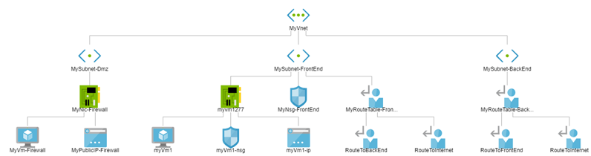
Platform Monitoring
Container Insights
Clusters, nodes, and pods and provides visual and actionable information
CPU and memory and logs for individual Kubernetes pods
Network Watcher - manages the network components using a collection of network monitoring and troubleshooting tools:
Traffic Analytics
Network Performance Manager
VPN diagnostics
Connection Monitor
Notes:
Container Insights
Clusters, nodes, and pods and provides visual and actionable information
CPU and memory and logs for individual Kubernetes pods.
Network Watcher - manages the network components using a collection of network monitoring and troubleshooting tools:
Traffic Analytics provides an overview of the traffic within Virtual Networks, as well as the percentage coming from malicious IP addresses, leveraging Microsoft Threat Intelligence databases.
Network Performance Manager can generate synthetic traffic to measure the performance of network connections over multiple links, giving you a perspective on the evolution of WAN and Internet connections over time, as well as monitoring information about Microsoft ExpressRoute circuits.
VPN diagnostics troubleshoots site-to-site VPN connections connecting applications to users on-premises.
Connection Monitor measures the network availability between sets of endpoints.

Slide 9

Monitoring Best Practices
Event correlation
Create shared dashboards in order to expose relevant information to different groups
Notifications
Action groups in Azure Monitor are used to notify multiple recipients, trigger automated actions
Define actions to be executed upon receiving certain alerts
Other monitoring tasks
Review Azure subscription limits
Understand Azure support plans
Monitor expiration dates of digital certificates
See: Best practices for monitoring cloud applications
Notes:
Email shouldn’t be the single notification method for critical issues. Instead, define actions to be executed upon receiving certain alerts (such as scaling up or down) for the system to be self-healing.

Slide 10
Azure Monitor

Slide 11
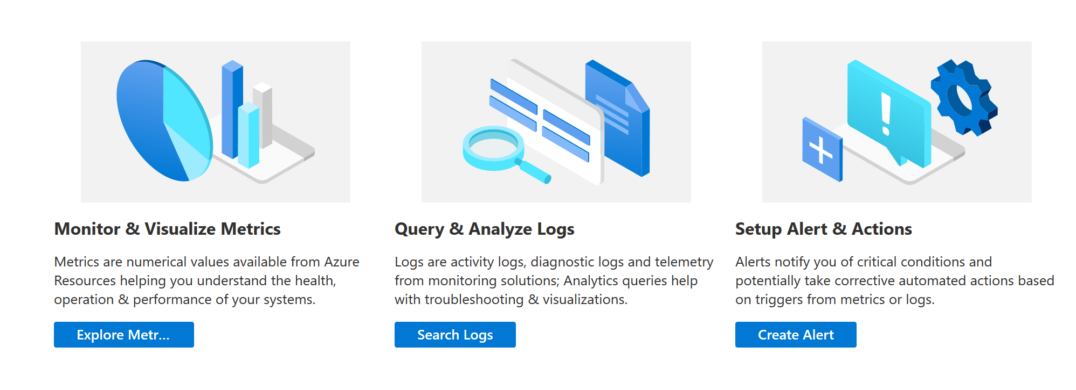
Monitoring Azure Resources with Azure Monitor
The Azure Monitor data platform collects data into logs and metrics where they can be analyzed together using a complete set of monitoring tools

Slide 12
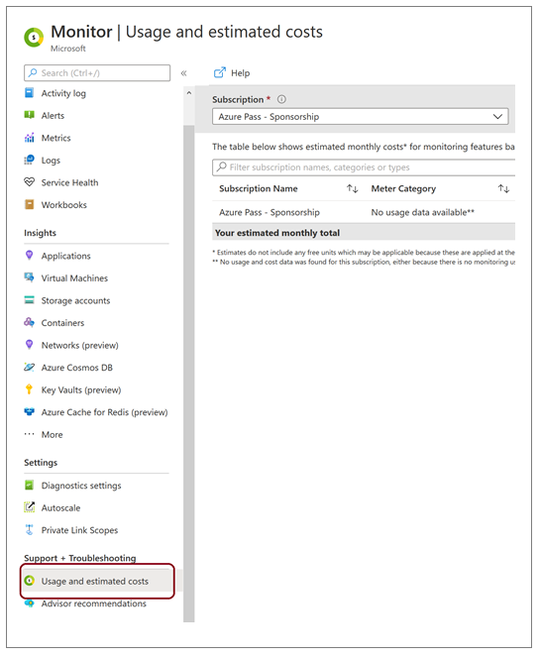
Costs Associated with Monitoring
There is no cost for analyzing monitoring data that is collected by default:
Platform Metrics
Activity Log
Alert Rules

Slide 13
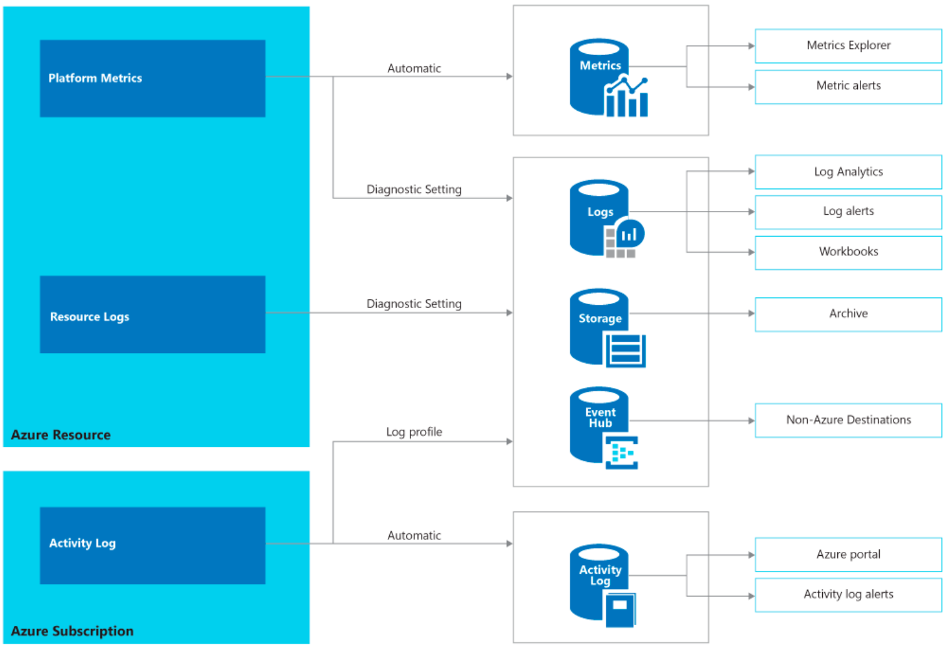
Monitoring Data
Platform metrics
Resource logs
Activity log
Notes:
Platform metrics - Numerical values that are automatically collected at regular intervals and describe some aspect of a resource at a time.
Resource logs - Provide insight into operations that were performed within an Azure resource (the data plane).
Activity log - Provides insight into the operations on each Azure resource in the subscription from the outside (the management plane), for example creating a new resource or starting a virtual machine.

Slide 14
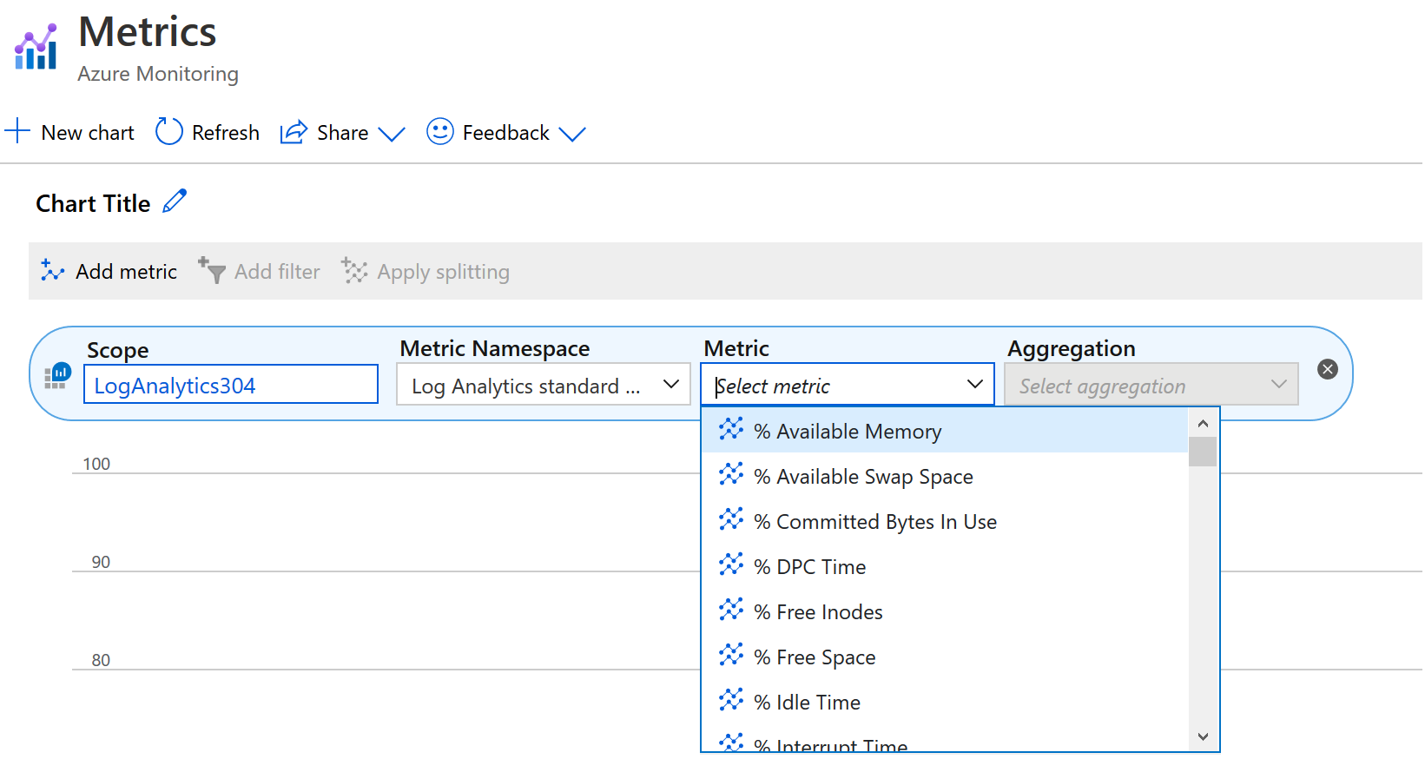
Configure Monitoring
Monitoring data is collected automatically
Platform metrics - Platform metrics are collected automatically
Resource logs - diagnostic setting
Activity log - The Activity log is collected automatically
Notes:
Monitoring data is collected automatically, but you may need to perform configuration depending on your requirements.
Platform metrics - Platform metrics are collected automatically into Azure Monitor Metrics with no configuration required. Create a diagnostic setting to send entries to Azure Monitor Logs or to forward them outside of Azure.
Resource logs - Resource logs are automatically generated by Azure resources but not collected without a diagnostic setting. Create a diagnostic setting to send entries to Azure Monitor Logs or to forward them outside of Azure.
Activity log - The Activity log is collected automatically with no configuration required and can be view in the Azure portal. Create a diagnostic setting to copy them to Azure Monitor Logs or to forward them outside of Azure.

Slide 15
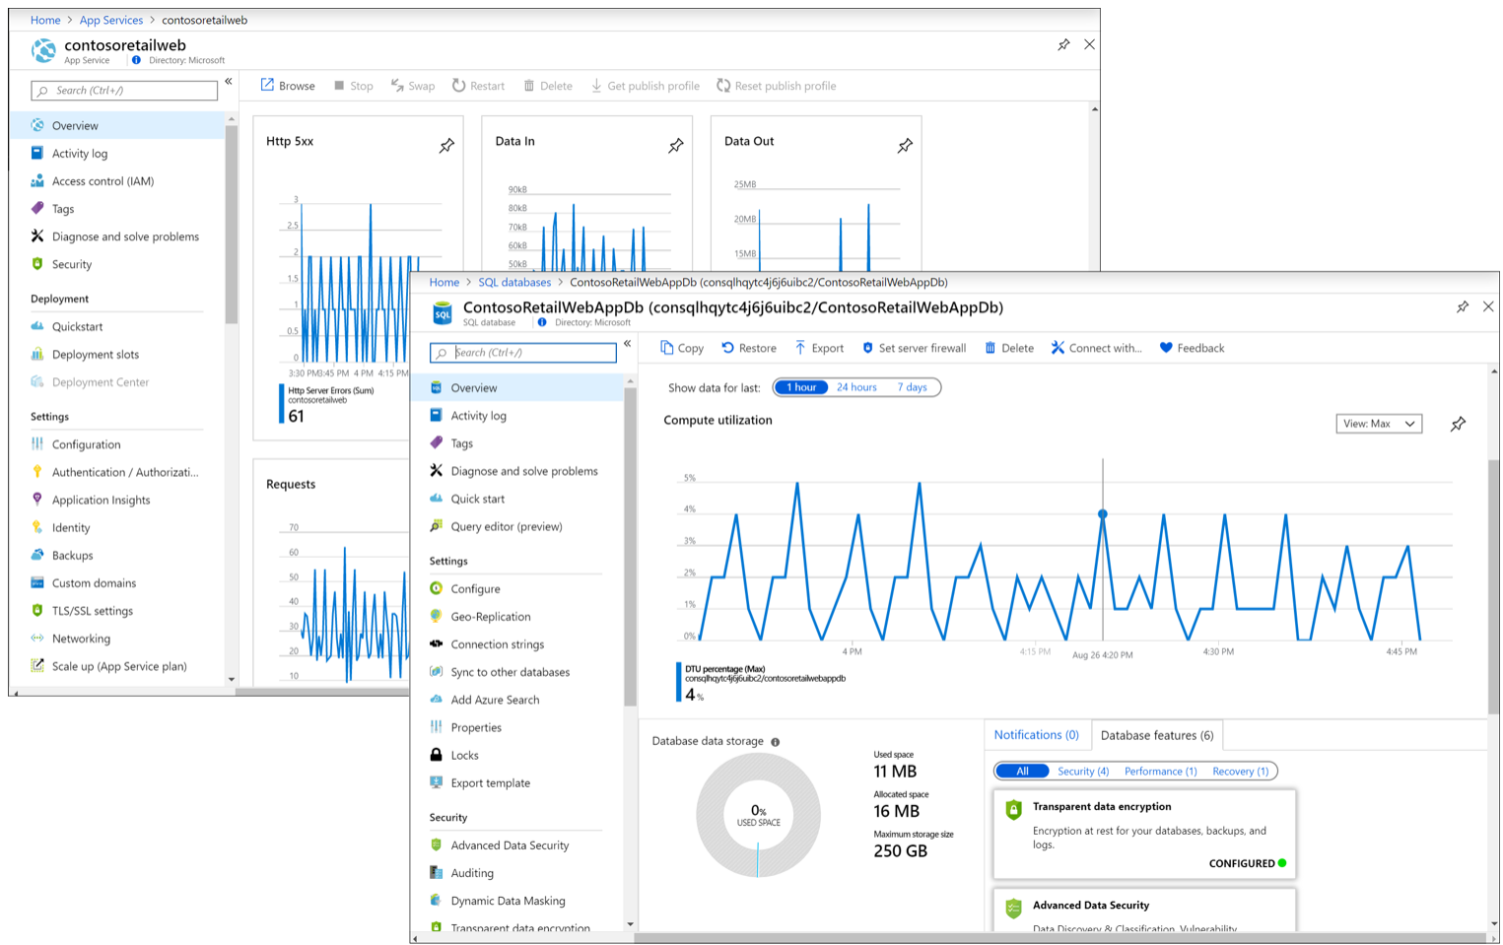
Monitoring in the Azure Portal
Monitor data from the Overview page
Notes:
Services include monitoring data on their Overview page as a quick glance of operation based on a subset of platform metrics stored in Azure Monitor Metrics.

Slide 16
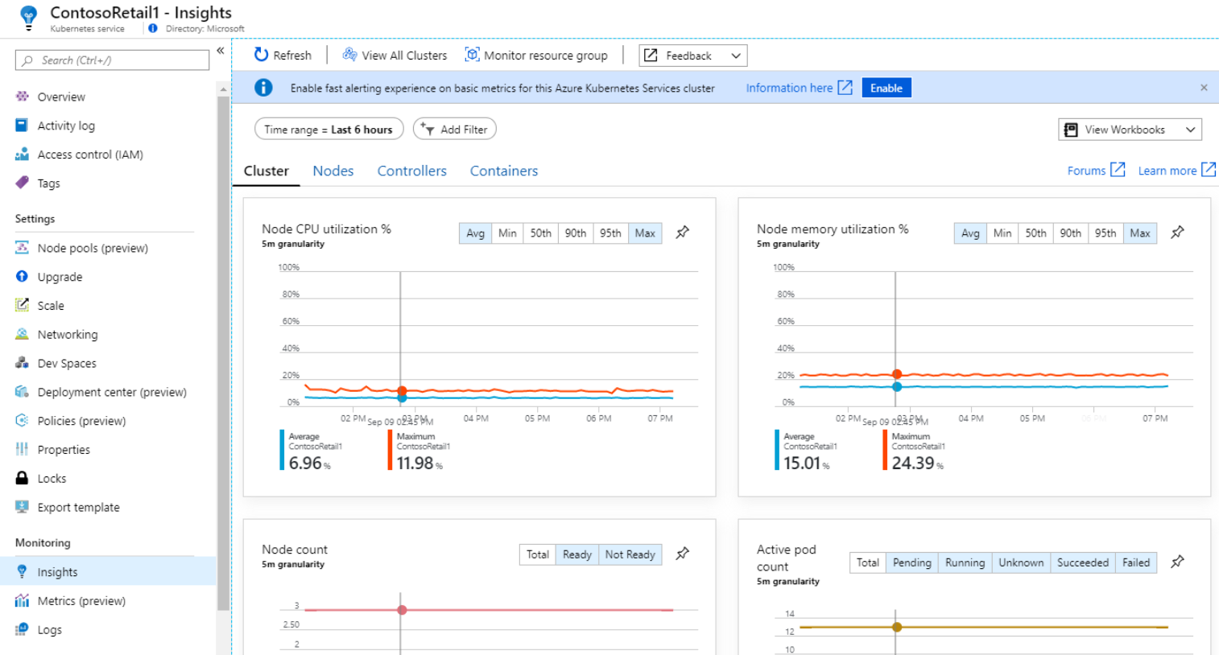
Insights and Solutions
Customized monitoring experience
Predefined monitoring logic
Notes:
Insights provide a customized monitoring experience for applications and services. They store data in the Azure Monitor data platform and leverage other Azure Monitor features for analysis and alerting but may collect additional data and provide a unique user experience in the Azure portal. Access insights from the Insights section of the Azure Monitor menu in the Azure portal.

Slide 17
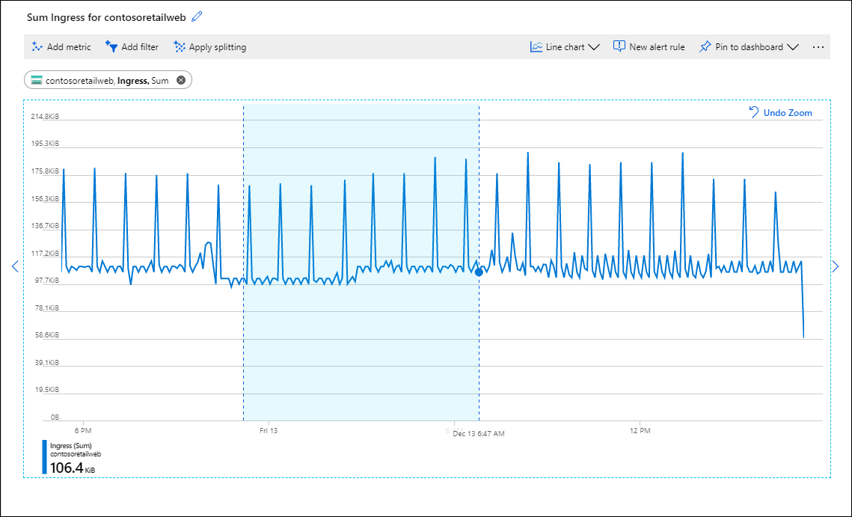
Azure Monitor Metrics
Metrics are stored in a time-series database
Analyzing time-stamped data
Alerting and fast detection of issues
Combine with logs to identify root causes
Notes:
The chart shows a log analytics screen - should change to Metrics

Slide 18
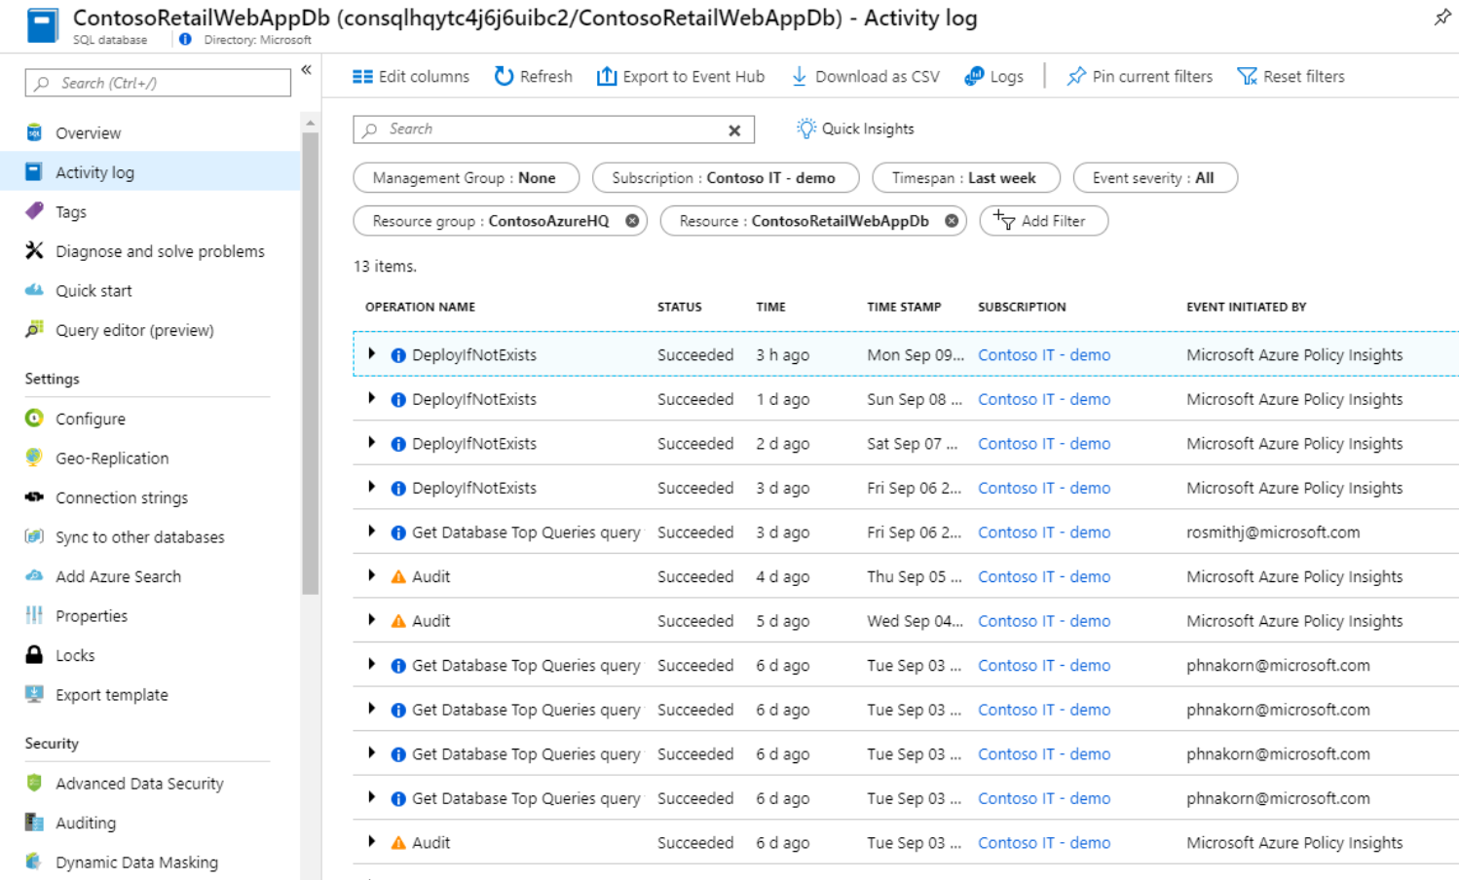
Activity Log
Initial filter set to the current resource
Copy it to a Log Analytics workspace to use with log queries and workbooks

Slide 19
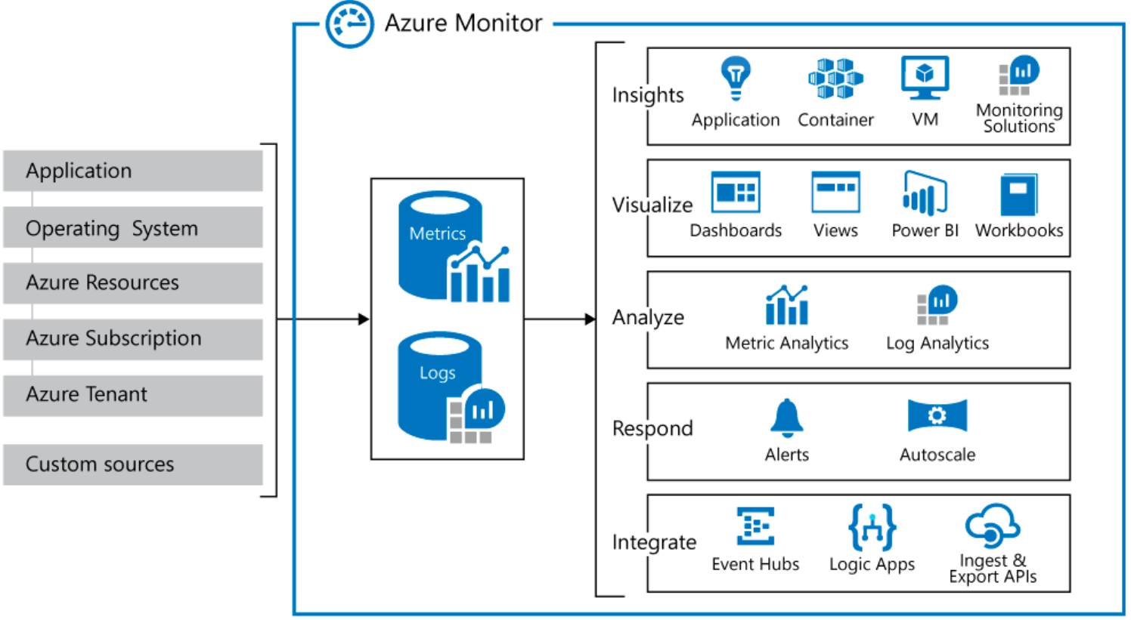
Azure Monitor Logs
Data stores for metrics and logs
Sources of monitoring data: Azure, operating systems, and custom sources
Analysis, alerting, and streaming to external systems

Slide 20
Compare Azure Monitor Metrics and Logs
Attribute | Metrics | Logs
Benefits | Lightweight and capable of near-real time scenarios such as alerting. Ideal for fast detection of issues | Analyzed with rich query language ideal for deep analysis and identifying root cause
Data | Numerical values only | Text or numeric data
Structure | Standard set of properties including sample time, resource being monitored, a numeric value. Some metrics include multiple dimensions for future definition. | Unique set of properties depending on the log type
Collection | Collected at regular intervals. | May be collected sporadically as events trigger a record to be created.
View in Azure Portal | Metrics Explorer | Log Analytics
Data Source Include | Platform metrics collected from Azure resources. Applications monitored by Applications Insights. Custom defined by application or API | Application and resource logs. Monitoring solutions. Agents and VM extensions. Application request and exceptions. Azure Security Center. Data Collector. API.
Notes:
Convert to table, bigger fonts, source of the table

Slide 21
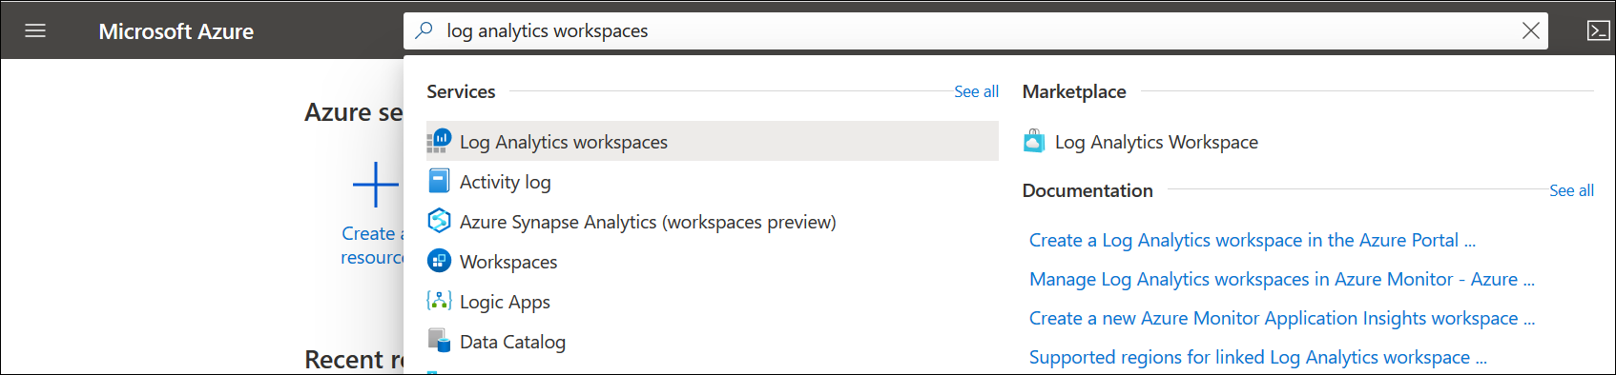
Azure Monitor in a Log Analytics Workspace
Log data from Azure Monitor in a Log Analytics workspace
Time-stamped logs about changes made to resources
Data is organized into records, with different properties
Logs can include numeric values and text data
Notes:
https://docs.microsoft.com/en-us/azure/azure-monitor/platform/design-logs-deployment

Slide 22
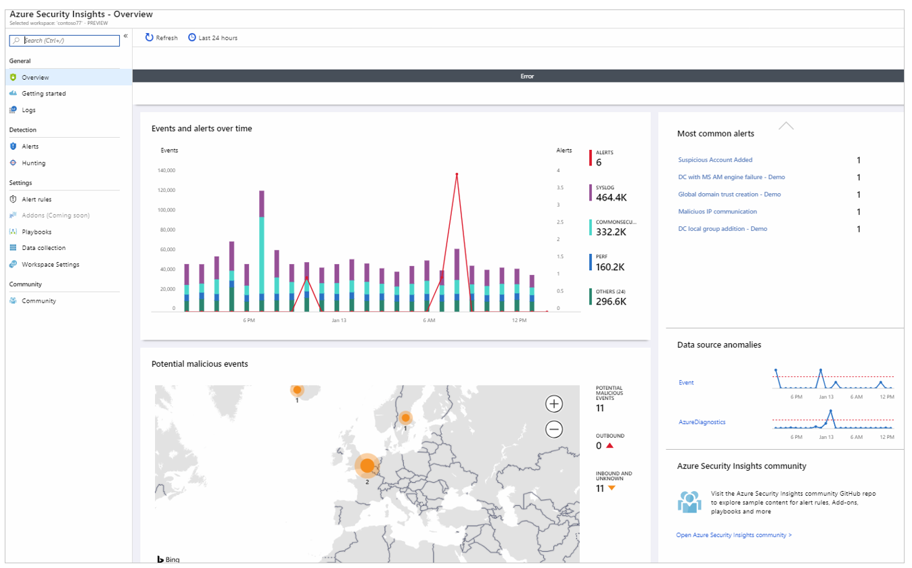
Azure Sentinel
Built-in threat intelligence for detection and investigation
Collects data on the devices, users, infrastructure, and applications
Cloud and on-prem monitoring/management
Investigates threats using AI
Security information event management (SIEM)
Notes:
Microsoft Azure Sentinel is a security information event management (SIEM) and security orchestration automated response (SOAR) solution
Collect data at cloud scale across all users, devices, applications, and infrastructure, both on-premises and in multiple clouds.
Detect previously undetected threats, and minimize false positives using Microsoft's analytics and unparalleled threat intelligence.
Investigate threats with artificial intelligence, and hunt for suspicious activities at scale, tapping into years of cyber security work at Microsoft.
Respond to incidents rapidly

Slide 23
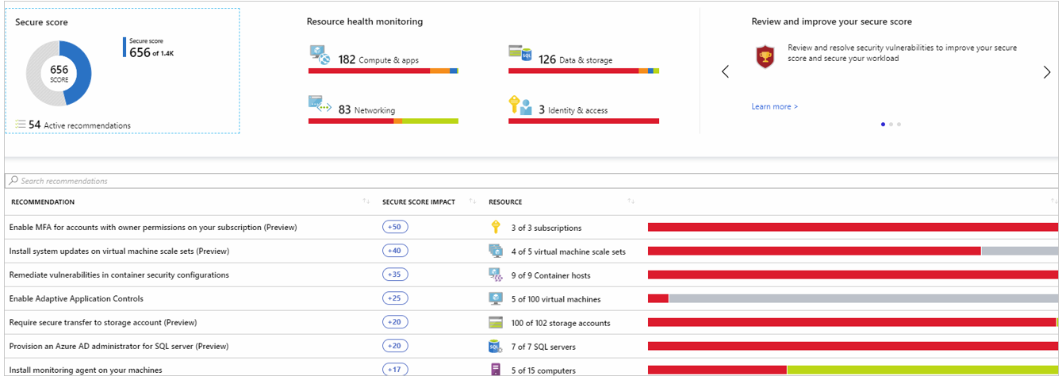
Azure Security Center
Manages infrastructure security from a centralized location
Monitors security of workloads on-premises or in the cloud
Monitors the health of resources and implements recommendations
Notes:
Azure Security Center is a unified infrastructure security management system that strengthens the security posture of your data centers and provides advanced threat protection across your hybrid workloads in the cloud - whether they're in Azure or not - as well as on premises.

Slide 24
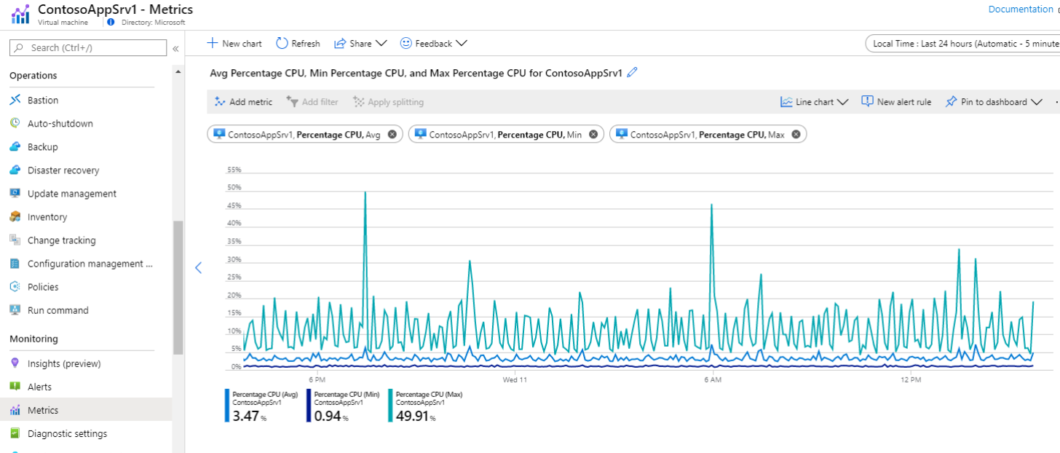
Demonstration - Monitor Azure Resources with Azure Monitor
This demonstration provides a walkthrough of the data that's automatically collected for a resource and how to view it in the Azure portal for a resource

Slide 25
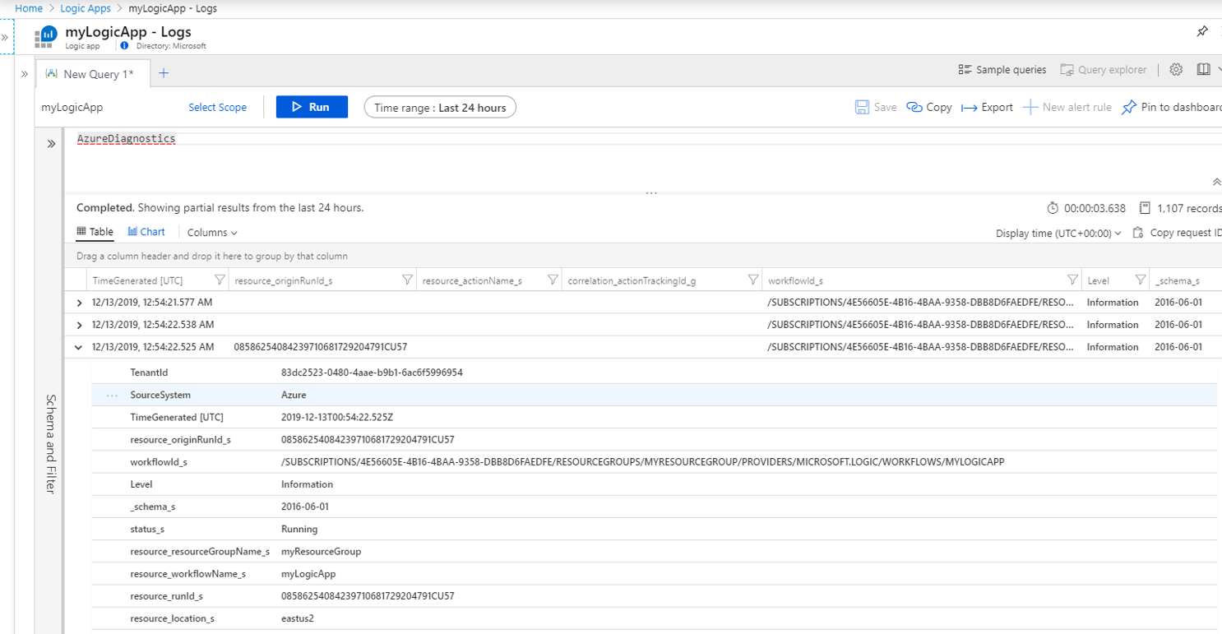
Demonstration - Collect and Analyze Resource Logs for Azure Resources
In this demonstration, you see how to:
Create a Log Analytics workspace in Azure Monitor
Create a diagnostic setting to collect resource logs
Create a simple log query to analyze logs

Slide 26
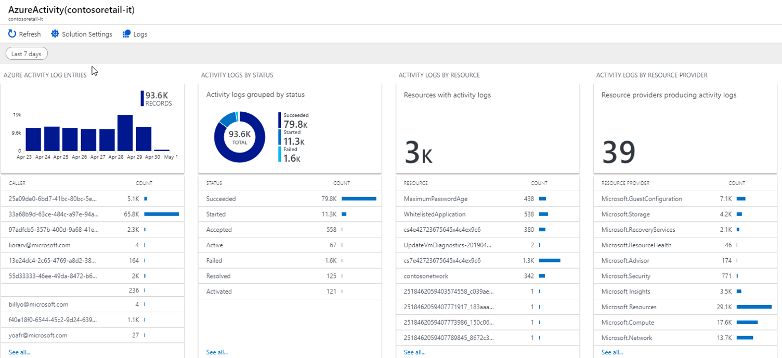
Demonstration - Collect and Analyze Activity Logs in Azure Monitor
This demonstration shows how to configure Azure Activity logs to be sent to a Log Analytics workspace

Slide 27

Module 9 Review Questions

Slide 28
Online Role-based training resources: Microsoft Learn https://docs.microsoft.com/en-us/learn/

Slide 29
Thank you.

